Slide 1
EE5907/EE5027 Week 6: Bayesian Statistics
BT Thomas Yeo
ECE, CSC, CIRC, N.1, HMS

Slide 2
Last Week Recap
Non-parametric approaches do not mean no parameters, but instead parameters grow with more data
Do not assume data is from specific distributions, such as Gaussian
Less assumptions imply non-parametric approaches need more data
Two problems: density estimation and classification
Two approaches
Parzen’s window: Count number of neighbors inside fixed window size
KNN: Expand window until K neighbors are captured
Notes:
In KNN, we expand the window until we capture K nearest neighbors.

Slide 3
This week
Problems With MAP estimation
Bayesian model selection
Bayesian decision theory
Notes:
This week, I will discuss some random topics on Bayesian statistics that I find interesting.

Slide 4
Problems With MAP Estimation
Notes:
So the Bayesian way of doing things is to compute the posterior distribution.
But the posterior distribution can sometimes be very complex, so it’s useful to summarize the posterior distribution into a few numbers.
If these few numbers are representative of the posterior, then this would give us some useful insights into the posterior.

Slide 5
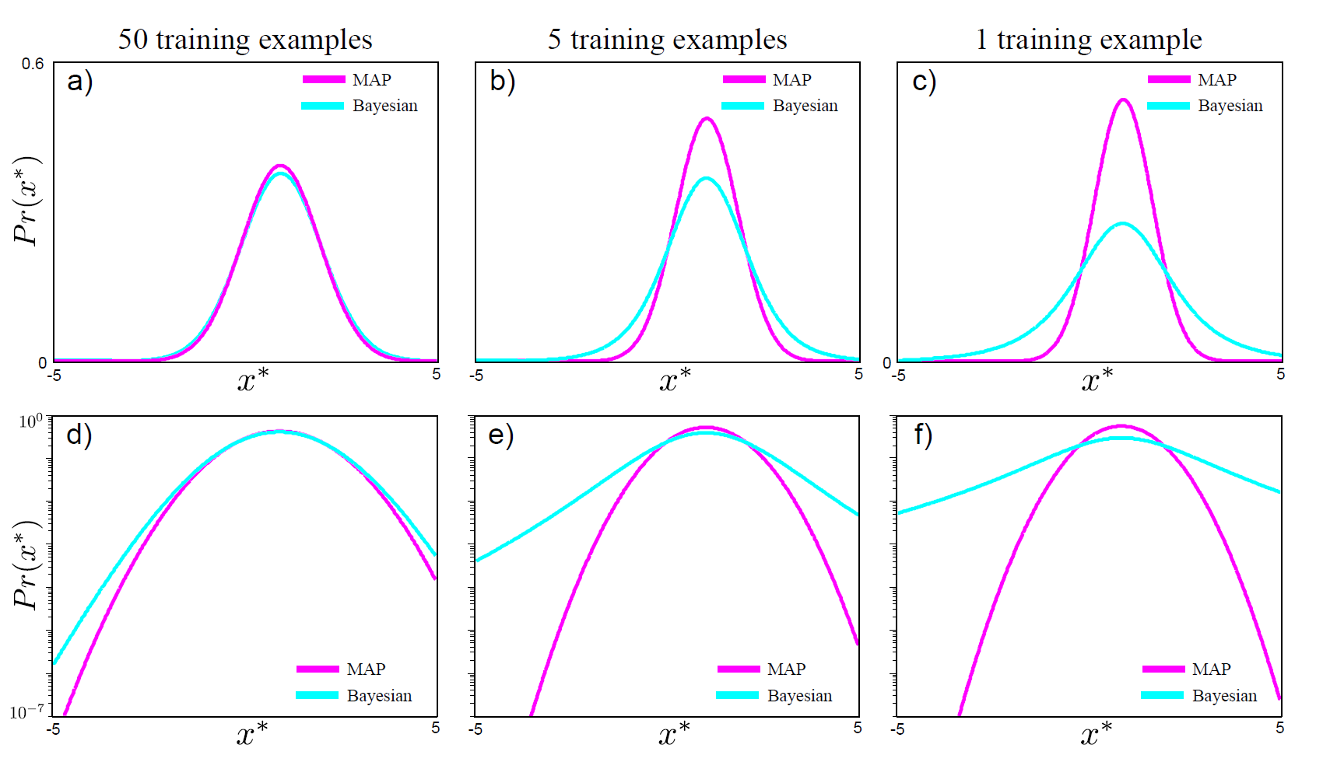
MAP Problems
log-scale
Notes:
One popular summary of the posterior distribution is of course the MAP estimate or the mode of the posterior distribution.
However as explained a few lectures ago, using the MAP estimate as a plug-in approximation for future analysis can lead to the black swan paradox.
Remember this example from a few weeks ago?
In general the MAP estimate in purple has much smaller variance than the posterior predictive distribution, suggesting an over-confidence in our estimates.

Slide 6
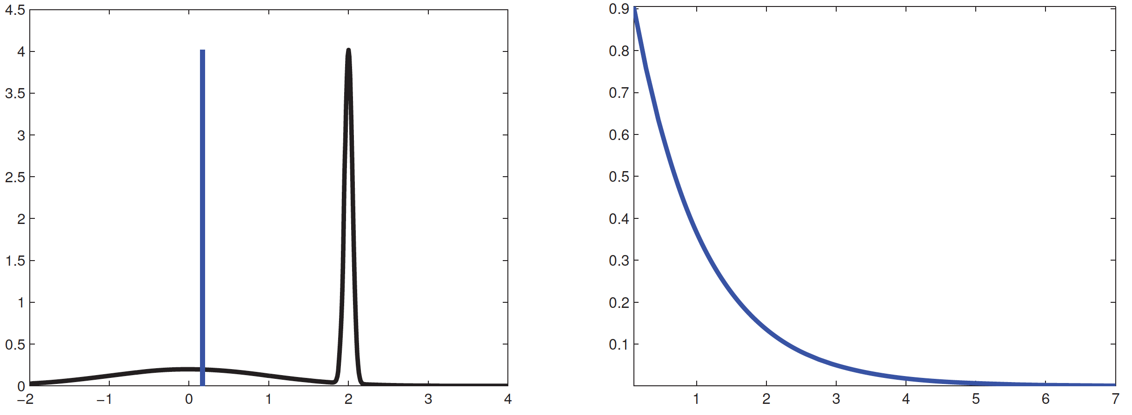
MAP Problems
Mean
Mode
Mode
pdf
Bimodal Distribution (black)
Skewed Distribution (blue)
Notes:
In addition, the mode of a distribution can be atypical because it’s just the highest point of the distribution, corresponding to zero measure. This is unlike the mean or median of a distribution which takes into account of the volume of the distribution.
For example, consider the black bi-modal distribution on the left. The mode corresponds to this peak here. But perhaps the mean shown in blue is a better summary of the distribution.
The right shows a skew distribution. The MODE corresponds to an extreme value in the distribution. Mean or median might be a better summary of the distribution.

Slide 7
MAP Problems
Notes:
The mode of a distribution and therefore the MAP estimate is sensitive to parameterization.
For example, let y = f(x). Then the pdf of y is equal to the pdf of x TIMES the absolute value of dx dy. Note that this formula assumes that f is monotonic and invertible and x and y are single random variables, else the transformation is more complex.
Anyway, the result of this transformation however is that the mode of y is different from applying the function f to the mode of x.

Slide 8
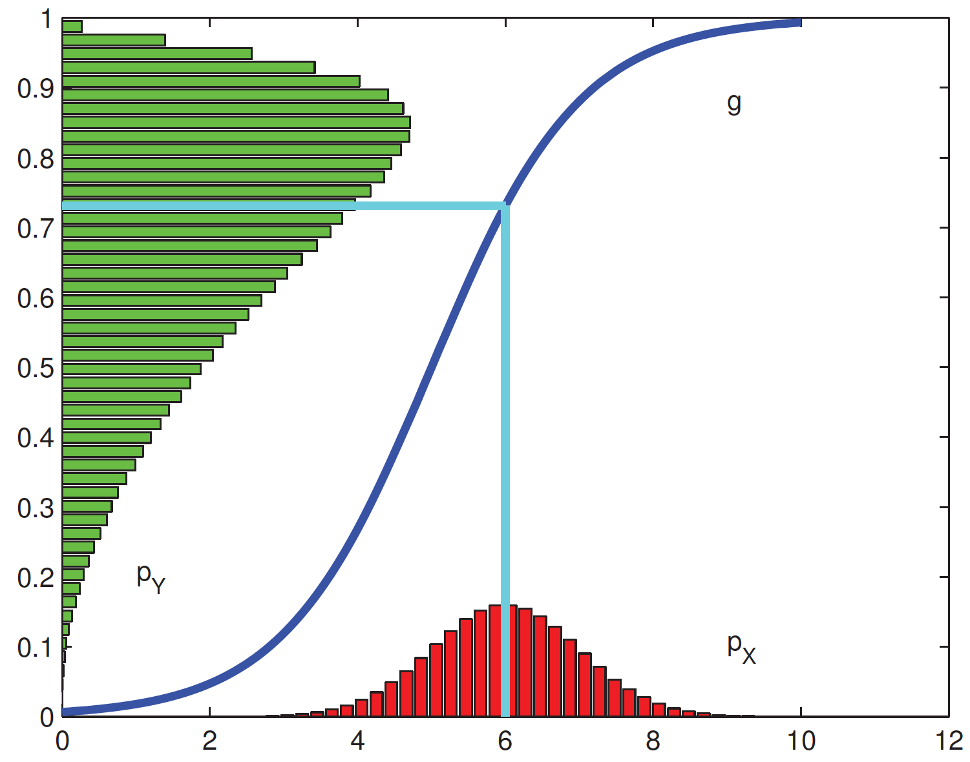
MAP Problems
Notes:
Here’s an example. X is a gaussian with mean 6 and standard deviation 1. This is shown by this red distribution here.
Suppose y is equal to 1 divided by 1 + e to the –x + 5. The resulting random variable y has a distribution shown in green.
The mode of x is of course 6, which if you plugged into the formula of y. 1 divided by e to the negative 6 + 5 is equal to 0.7. However, the mode of the green distribution is between 0.8 and 0.9.
This is very troubling because the definition of random variables can be a little arbitrary. For example, the heights of students can be expressed in terms of centimeters or meters. And so we do not want our unit of measures which is very arbitrary to affect our modeling.
Note that Maximum likelihood and posterior predictive estimation do not face such re-parameterization issues.

Slide 9
Bayesian Model Selection
Notes:
Let’s move on to Bayesian model selection.
Any questions before I continue?

Slide 10
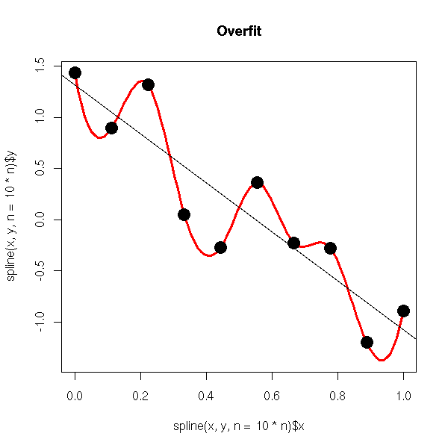
Overfitting
Can exactly fit N+1 data points
with N-degree polynomial
Images from google images
Notes:
As mentioned in previous lectures, it is important to pick the model of the “right” complexity to prevent overfitting.
For example, suppose we want to fit a line to these bunch of black dots, the red line fits the black dots perfectly. However, it’s likely that the red line would poorly predict NEW datapoints.
On the other hand, the black linear fit seems quite reasonable.

Slide 11
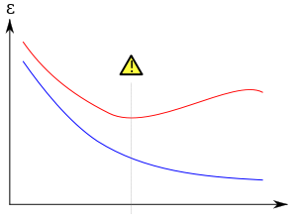
Overfitting
Test Error
Training Error
Model Complexity
Can exactly fit N+1 data points
with N-degree polynomial
Images from google images
Notes:
This can be quantified if we split our data into training and test sets.
In general if the model is too complex, we can achieve very low error in the training set, but high test error.
On the other hand, if the model is too simple, both training and test errors will be bad.
In general, we want to achieve this sweet spot here, where test error is lowest.

Slide 12
Overfitting
Test Error
Training Error
Model Complexity
Can exactly fit N+1 data points
with N-degree polynomial
Images from google images
Notes:
In previous weeks, we have discussed how we can reduce overfitting by using regularization or cross-validation.
Regularization involves adding some constraints or priors on our model. For example, in the lecture on logistic regression, we added l2 regularization to the cost function.
We have also talked about the use of cross-validation. Just to remind you, this involves dividing our data into 3 groups, training set, validation set and test set. We perform cross-validation on the training and cross-validation dataset to find the model with the best complexity. And then we can retrain on the combined training and cross-validation set. And then we can test our final algorithm on the test set.
In practice, people tend to use a combination of both regularization and cross-validation together.

Slide 13
Overfitting
Test Error
Training Error
Model Complexity
Can exactly fit N+1 data points
with N-degree polynomial
Images from google images
Notes:
Today, I will talk about a third approach, which is Bayesian model selection.
Bayesia model selection is theoretically the most rigorous, but computationally much more difficult, so usually some approximation have to be made in real problems.
In practice, I think cross-validation works better than Bayesian model selection, but because this is an important conceptual idea, so let’s elaborate on this approach.

Slide 14
Bayesian Occam’s Razor
Notes:
Suppose we have a bunch of models m. We can apply what we have learned so far in the past few lectures to try to compute the posterior probability of different models given the data.
We can then pick the model m with the highest posterior probability.

Slide 15
Bayesian Occam’s Razor
Notes:
We can then apply Bayes rule and so this is equivalent to finding model m that maximizes the likelihood p(D | m) and the model prior p(m).

Slide 16
Bayesian Occam’s Razor
Notes:
Assuming all models are equally likely, we end up with the likelihood of the data given the model.

Slide 17
Bayesian Occam’s Razor
Notes:
p(D | m) is called the marginal likelihood

Slide 18
Bayesian Occam’s Razor
Notes:
We have actually seen this before. Suppose we observe D Gaussian samples and we want to estimate the Gaussian parameters theta consisting of the mean and variance.

Slide 19
Bayesian Occam’s Razor
Notes:
Suppose we use MAP estimation, so MAP estimate of theta is obtained by maximizing the posterior p of theta GIVEN D.

Slide 20
Bayesian Occam’s Razor
Notes:
We can apply Bayes rule, so we get prior p of theta TIMES likelihood p(D | theta) DIVIDED by p of data D.

Slide 21
Bayesian Occam’s Razor
Notes:
We can drop the evidence p of D because it does not depend on theta and we are optimizing with respect to theta.

Slide 22
Bayesian Occam’s Razor
Notes:
The above actually implicitly depends on modeling assumptions. For example, normal inverse gamma prior with specific hyperparameters.

Slide 23
Bayesian Occam’s Razor
Notes:
Therefore, there is an implicit conditioning on the model m.
So it should really be written as p(theta | m) TIMES p(D | theta, m) divided by p(D | m)

Slide 24
Bayesian Occam’s Razor
Notes:
Therefore the evidence term p(D) we throw away is actually the same as the marginal likelihood p(D|m).

Slide 25
Why does it work?
Notes:
So why does this work? One might think that complex models will fit the data better and result in higher evidence. But that is not true.
The reason is that complex models can explain many things, so this means that the p of data D’ given the complex model m is non-zero for many different D’.

Slide 26
Why does it work?
Notes:
However, remember that p of D’ given m is a probability distribution? Therefore, sum or integral over p of D’ given model m has to be equal to 1.
If model m is a complex model, then p of D’ given m is non-zero for many different D’, which means that for a particular D’, the p(D’ | m) cannot be so big.
Does this sound too abstract? Let me give you an example.

Slide 27
Why does it work?
Notes:
Suppose we are doing curve fitting. The dots here actually comes from a quadratic curve.

Slide 28
Why does it work?
Notes:
Suppose M1 is a simple model consisting of the space of all linear curves.
The problem is that linear straight lines cannot fit the dots very well, so the probability of observing these dots given that the underlying curve is linear cannot be very high.

Slide 29
Why does it work?
Notes:
On the other hand, let’s consider a very complex model M3, consisting of the space of all possible linear, quadratic and cubic curves.
Now, among the space of linear, quadratic and cubic curves, we can obviously find a quadratic curve that fits the data well, but remember the model is quite complex. It has to assign non-zero probabilities not just to linear and quadratic curves, but also cubic curves.
Therefore even though the probability of observing a quadratic curve under this M3 model is non-zero, but the probability cannot be that big, because the model has to allocate some non-zero probabilities to cubic curves.

Slide 30
Why does it work?
✓
Notes:
Now consider an intermediate model M2 consisting of the space of linear AND quadratic curves.
Now, among the space of linear and quadratic curves, we can obviously find a quadratic curve that fits the data well.
M2 assigns 0 probability to cubic curves. It only needs to divide its probability mass over linear and quadratic curves. Therefore the probability of observing these dots given that the underlying curve is linear or quadratic is the highest and we can pick M2 as the best model.

Slide 31
Computing Marginal Likelihood / Evidence
Notes:
So how can we compute this evidence?
As I mentioned just now, in the previous class we often discard the evidence p of D given m because when we have only one model, we can consider p of D given m to be a constant.

Slide 32
Computing Marginal Likelihood / Evidence
Notes:
But now we want to compare multiple models, so the evidence or marginal likelihood of D becomes important.

Slide 33
Computing Marginal Likelihood / Evidence
Notes:
Computing the evidence is easy when we have conjugate distributions. The reason is that the posterior p(theta | D) is easy to compute, so we can write down Bayes rule, then solve for the evidence p(D).
The evidence p of D is equal to the likelihood TIMES the prior DIVIDED by the posterior distribution.

Slide 34
Computing Marginal Likelihood / Evidence
Notes:
For example, consider the beta-binomial model where the likelihood is binomial with N0 tails and N1 heads and theta is the probability of head.
The prior of theta is beta with parameters a and b.
The posterior distribution as we have shown two lectures ago is Beta with parameters a + N1 and b+N0.

Slide 35
Computing Marginal Likelihood / Evidence
prior
likelihood
evidence
posterior
Notes:
So we can plug in p of theta to be the beta distribution 1 divided by Beta of a and b TIMES theta to the power of a – 1 TIMES (1 – theta) to the power of b-1.
And the likelihood is the binomial distribution N choose N1 TIMES theta to the power of N1 TIMES (1 – theta) to the power of N0.
Divided by the posterior which is a beta distribution 1 over Beta of a + N1 and b+N0 TIMES theta to the power of a + N1 – 1 TIMES (1-theta) to the power of b+N0-1.

Slide 36
Computing Marginal Likelihood / Evidence
Does not depend on Θ → “Beta-binomial compound distribution” parameterized by a and b
Notes:
So all the theta terms cancel out and we are left with N choose N1 TIMES Beta of a+N1 and b+N0 DIVIDED by Beta of a and b.
Notice that this does not depend on theta, which makes sense. We can think of p of D as a distribution parameterized by the beta parameters a and b. This is called the Beta-binomial compound distribution
Now in general, it is quite difficult to compute the marginal likelihood.

Slide 37
Computing Marginal Likelihood / Evidence
Does not depend on Θ → “Beta-binomial compound distribution” parameterized by a and b
Notes:
So an approximation is the bayesian information criteria, where p of D is approximated to be the log probability of the data given the ML estimate MINUS the degree of freedoms of theta DIVIDED by 2 TIMES log N.
So we see that a more complicated model will generally result in a better log likelihood. On the other hand, a more complex model has higher degree of freedoms and therefore gets penalized in the second term.
The log N might seem weird. So the more the data, the more penalty there is. If there is more data shouldn’t we be able to fit more complex models?
Well actually there is no contradiction because the first term grows linearly with N, so as we accumulate more data the first term should grow linearly with N, while the second term grows logarithmically with N.

Slide 38
Computing Marginal Likelihood / Evidence
Does not depend on Θ → “Beta-binomial compound distribution” parameterized by a and b
Notes:
In some literature, people instead multiply BIC by -2, resulting in BIC cost. So the smaller the BIC cost the better the model

Slide 39
Computing Marginal Likelihood / Evidence
Does not depend on Θ → “Beta-binomial compound distribution” parameterized by a and b
Notes:
In addition, some literature suggests that using the MAP estimate of theta rather than the ML estimate might also work better.
The derivation of BIC can be found at the end of the lecture notes. I won’t go through it but you should definitely look at it in order to understand the approximations that are made, so you can decide for yourself whether the approximations are reasonable for your problem.
In addition, it will give you a better sense of how to compute the degree of freedoms of theta.

Slide 40
Bayes Factor
Notes:
Suppose we consider two models M0 and M1. Bayes factor is defined as the marginal likelihood of the data given model M1 DIVIDED by the marginal likelihood of the data given model M0.
In other words, evidence of M1 divided by evidence of M0.
This is the Bayesian alternative to hypothesis testing in frequentist statistics.

Slide 41
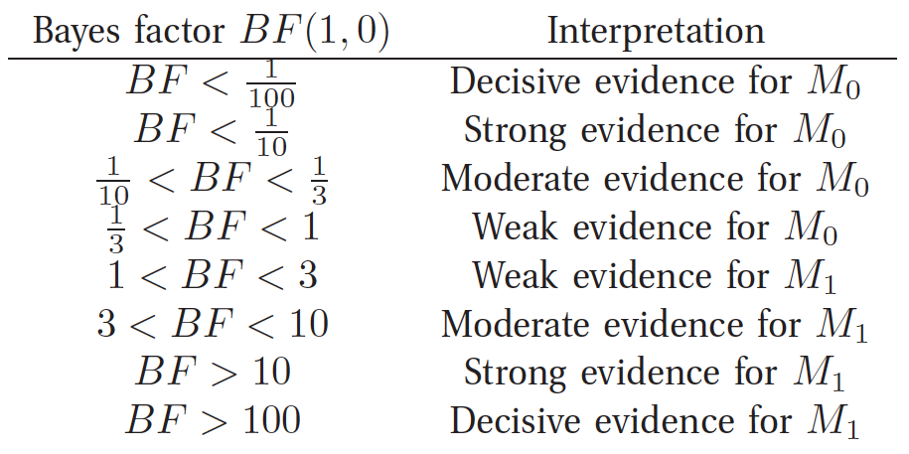
Bayes Factor
Notes:
We can interpret Bayes factor by using this table of convention proposed by Jeffreys.
If Bayes factor is < 1 over 100, this suggests decisive evidence for M0, while if Bayes factor is > 100, this suggests decisive evidence for model M1.
This might feel a bit arbitrary but so is using a p value of 0.05 in frequentist hypothesis testing like t-test.

Slide 42
Bayes Factor
Notes:
Assuming that both models have equal prior probability, we can write the posterior probability of model 0 as 1 divided by the Bayes factor + 1.
Let’s see an example to make things more concrete.

Slide 43
Example: Is a coin fair?
Notes:
Suppose we have a coin and we observe N1 heads out of N tosses.
In model 0, the coin is fair.
In model 1, the coin is potentially unfair where the probability of head theta is uniformly distributed with Beta distribution 1, 1. So it’s a uniform distribution.

Slide 44
Example: Is a coin fair?
Notes:
The marginal likelihood of the data for hypothesis 0 is N choose N1 TIMES 1 over 2 to the power of N. This is just the binomial distribution where we observed N1 heads and the coin is fair.
The marginal likelihood of the data for hypothesis 1 is N choose N1 TIMES the beta of 1+N1 and 1+N0 divided by beta of 1 and 1. This formula is simply from the beta-binomial COMPOUND distribution from a few slides ago.

Slide 45
Example: Is a coin fair?
Notes:
So what we are going to do is to ignore the factor N choose N1 because it appears in both models.
So if we ignore N choose N1, then p(D | M0) is a constant and so we just need to plot p of D given M1
Sounds good?

Slide 46
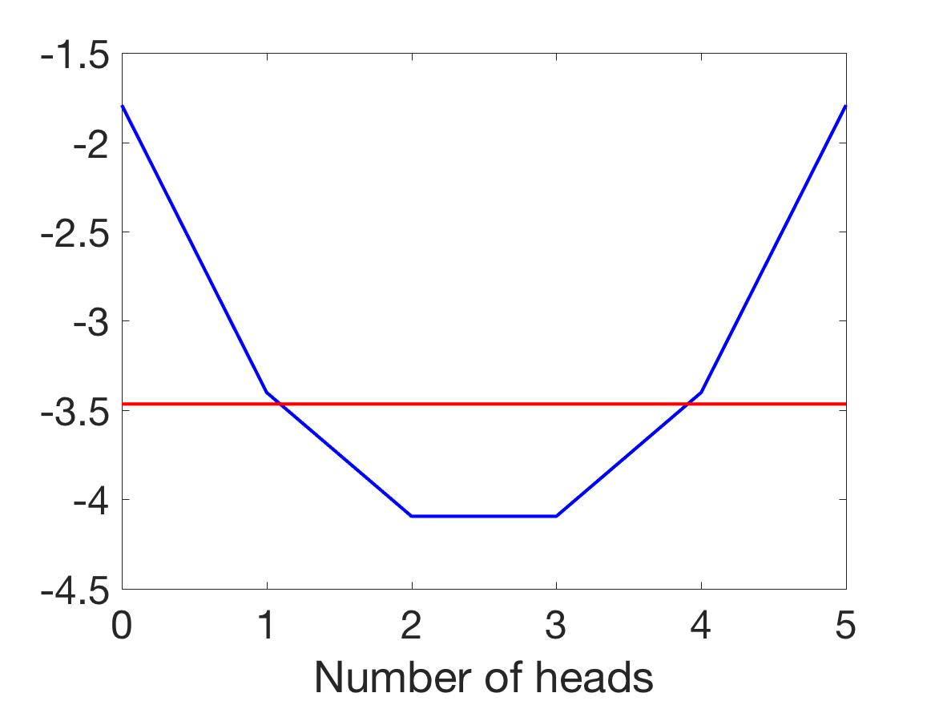
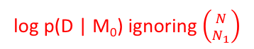
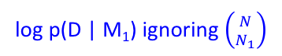
Example: Is a coin fair?
log p(D | M₁) ignoring $\left({N \atop N_{1}}\right)$
log p(D | M₀) ignoring $\left({N \atop N_{1}}\right)$
Notes:
So here’s the marginal likelihood of model 1 without the N choose N1 factor.
We are assuming 5 coin tosses.
We see that if we see that if there are 2 or 3 heads, then we should favor model 0. If we see 0 head or 5 heads, then model 1 becomes more likely.
In case you are wondering why there are a lot of 1s and 2s because they correspond to all the possible configuration. So with 1 head, the head can appears in first toss or second toss or third or fourth or fifth. So there are 5 1s here.

Slide 47
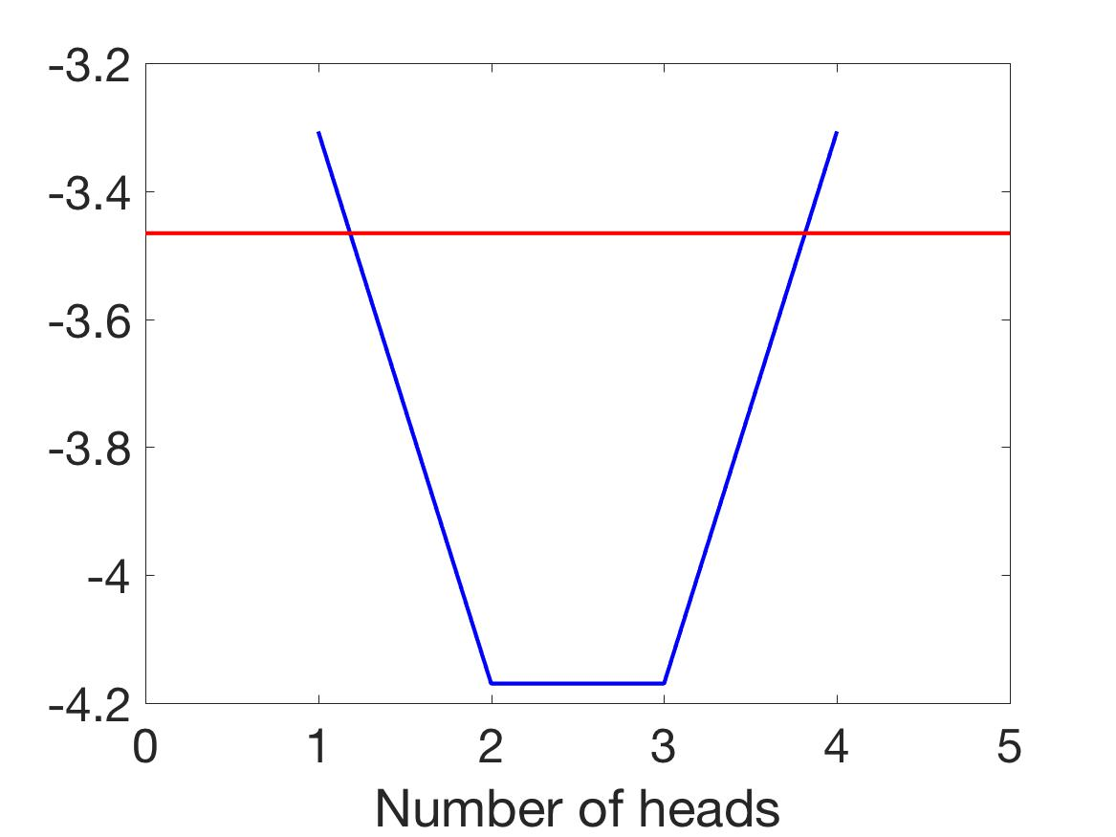
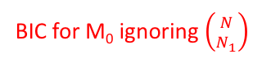
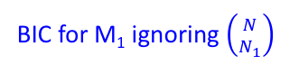
Example: Is a coin fair?
BIC for M₁ ignoring $\left({N \atop N_{1}}\right)$
BIC for M₀ ignoring $\left({N \atop N_{1}}\right)$
log p(D | M₁) ignoring $\left({N \atop N_{1}}\right)$
log p(D | M₀) ignoring $\left({N \atop N_{1}}\right)$
BIC for M₁ at 0 = NAN
BIC for M₁ at 5 = NAN
Notes:
Here’s the BIC approximation to the marginal likelihood.
And we see that the scale has changed a bit, but the basic shape is the same. For extreme values, we favor model 1, but for 2 or 3 heads we favor model 0.
Note that the BIC values for 0 head and 5 heads for. M1 correspond to NaN.

Slide 48
Bayesian Decision Theory
Notes:
I will now talk about Bayesian decision theory.
Any questions before I continue?

Slide 49
Posterior Expected Loss
Notes:
So let’s say we have estimated the posterior probability of some parameters of interest.
But in the real world we need to translate this posterior probability into action.

Slide 50
Posterior Expected Loss
Notes:
One common approach is to formulate this as a game against nature.
So imagine that nature picks the variable y, and from this variable generates observation x.

Slide 51
Posterior Expected Loss
Notes:
Based on this observation x, we have to choose an action a. For example, y is whether this is an incoming missile and a is whether we should hide in the bomb shelter or not.
Our action results in some penalty based on the compatibility between the true value of y and the action we take a.
This penalty is represented as a loss function L of y and a.
So for example, L of y and a can be (y – a) square.

Slide 52
Posterior Expected Loss
Notes:
We should then pick the action that minimizes the posterior expected loss.
So delta of x is the action we should take based on observing x.
This action should minimize the expected loss,

Slide 53
Posterior Expected Loss
Notes:
which is defined as the expectation with respect to the posterior probability p of y given the observation x.
Therefore this expectation is equal to sum over y. The loss of y and a TIMES the posterior probability of y GIVEN x.
Now, when I use sum, that’s because I assume y is discrete. But if y is a continuous variable, then this sum becomes an integral.

Slide 54
Posterior Expected Loss
Notes:
The resulting action is called the Bayes’ estimator or Bayes decision rule.

Slide 55
Posterior Expected Loss
Notes:
In economics, instead of talking about losses, we talk about rewards.
So instead we define a reward or utility function U of y and a.
In that case, the Bayes’ estimator is the action that maximizes the posterior expected utility.
I will now give you some examples of loss functions and the resulting Bayes’ estimator.

Slide 56
MAP Estimate Minimizes 0-1 Loss
Notes:
A very common loss function is 0-1 loss.
So L of y and a is equal to 0 if a is equal to y and 1 if a is not equal to y.

Slide 57
MAP Estimate Minimizes 0-1 Loss
Notes:
For example, in classification, y would be the true label and a would be the estimated label.
And so the loss would simply be the classification error, which is the number of datapoints we classify wrongly.

Slide 58
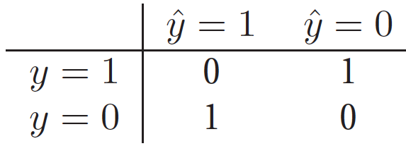
MAP Estimate Minimizes 0-1 Loss
Notes:
For binary classification, we can visualize the loss function with this matrix.
This corresponds to the true y, while y HAT corresponds to the predicted y.
So if true y is equal to predicted y, then we get 0 penalty. If true y is NOT equal to predicted y, then we get a penalty of 1.

Slide 59
MAP Estimate Minimizes 0-1 Loss
Notes:
So the posterior expected loss rho of a GIVEN x is defined as sum over y Loss function of y and a TIMES the posterior probability of y given x.
Plugging in the 0-1 loss, this is equal to

Slide 60
MAP Estimate Minimizes 0-1 Loss
Notes:
The probability that y is not equal to a GIVEN x.

Slide 61
MAP Estimate Minimizes 0-1 Loss
Notes:
This is equal to 1 MINUS the probability that y is equal to a given x.

Slide 62
MAP Estimate Minimizes 0-1 Loss
Notes:
So minimizing 1 – p of y equal a GIVEN x is equivalent to maximizing the posterior probability that y is equal to GIVEN x, which is MAP estimation.
Therefore MAP estimation minimizes 0-1 loss.

Slide 63

Posterior Mean Minimizes $l2$ Loss
Notes:
Another common loss is quadratic loss or L2 loss, which is defined as (y – a) Square

Slide 64
Posterior Mean Minimizes $l2$ Loss
Notes:
So the posterior expected loss rho (a | x) is defined as sum over y Loss function of y and a TIMES the posterior probability of y given x.

Slide 65
Posterior Mean Minimizes $l2$ Loss
Notes:
Plugging in L of y and a equal to (y – a) square, we get the expectation of (y – a) square conditioned on knowing x.
So again, this expectation is with respect to the posterior p(y | a).

Slide 66
Posterior Mean Minimizes $l2$ Loss
Notes:
We can expand (y – a) square to become y square – 2 a y + a square.
So by linearity of expectation, we get expectation of y square given x MINUS 2 a TIMES expectation of y given x + a square.

Slide 67
Posterior Mean Minimizes $l2$ Loss
Notes:
Differentiating with respect to a, the first term does not contain a, so it’s gone.
The second term MINUS 2 a expectation of y GIVEN x becomes -2 expectation of y given x.
The third term a square becomes 2 a.
And setting the derivative to 0,

Slide 68
Posterior Mean Minimizes $l2$ Loss
Notes:
We get that a is the expectation of y conditioned on knowing x, in other words, this is the posterior mean of y given x.

Slide 69
Posterior Mean Minimizes $l2$ Loss
Notes:
Therefore the posterior mean is the minimum mean squared error estimate.

Slide 70
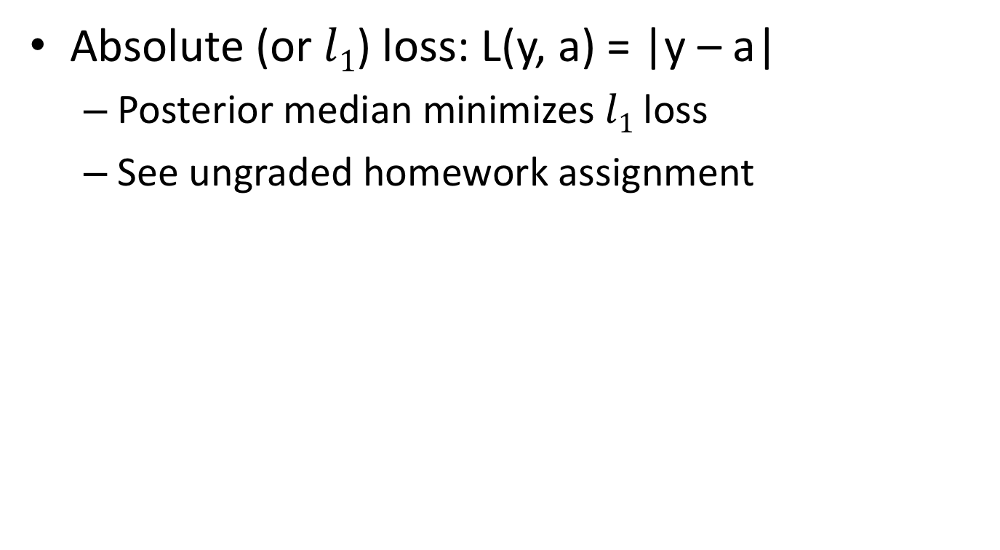

Posterior Median Minimizes $l1$ Loss
Absolute (or $l1$) loss: L(y, a) = |y – a|
Posterior median minimizes $l1$ loss
See ungraded homework assignment
Notes:
Another common loss is absolute loss or L1 loss, which is defined as the absolute difference between y and a.
While the posterior mean minimizes the l2 loss, the posterior median minimizes l1 loss.
You will be asked to prove this in the homework assignment

Slide 71
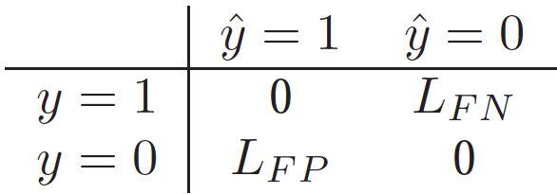
False Positive – False Negative Tradeoff
Notes:
Now let’s go back to the case of binary classification.
If the true label is 1, and the estimated label is 0, this is called a false negative or missed detection, and we can give it an associated cost LFN, where FN stands for false negative.
If the true label is 0, and the estimated label is 1, this is called a false positive or false alarm, and we can give it and associated cost LFP, where FP stands for false positive.
If the false negative cost and false positive cost are the same, then we get the 0-1 loss which we discussed.
But in real situations, we might not want them to be the same. For example, if the classification problem is whether there is an incoming missile, then a false negative cost might be much bigger than a false positive cost. It’s better to be safe than sorry.

Slide 72
False Positive – False Negative Tradeoff
Notes:
So in this case, the posterior expected loss for the two actions are as follows.
The posterior expected loss of predicting that y is equal to 0 given the observation x is EQUAL to the posterior probability that the true label is 1 TIMES the FALSE NEGATIVE cost.
The posterior expected loss of predicting that y is equal to 1 given the observation x is EQUAL to the posterior probability that the true label is 0 TIMES the FALSE POSITIVE cost.

Slide 73
False Positive – False Negative Tradeoff
Notes:
Therefore, we should predict that y is equal to 1 if and only the posterior expected cost of predicting 0 is greater than the posterior expected cost of predicting 1.

Slide 74
False Positive – False Negative Tradeoff
Notes:
So if we plug in the above equations, we find that we should predict y is equal to 1 if and only if the posterior probability of y equal to 1 DIVIDED by the posterior probability of y equal to 0 is GREATER than the false positive cost DIVIDED by the false negative cost.
Therefore given a false positive cost and false negative cost, we can come up with an optimal threshold in deciding whether to predict whether a label is 1 or 0.
So far so good?

Slide 75
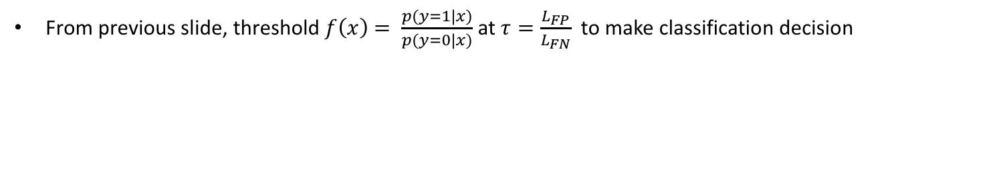
Different Metrics
From previous slide, threshold $f\left(x\right)$ $= \frac{p(y=1|x)}{p(y=0|x)}$ at $τ=\frac{L_{FP}}{L_{FN}}$ to make classification decision
Notes:
So from the previous slide, we have the ratio of the posterior of class 1 given feature x DIVIDED by the posterior of class 0 GIVEN x. Let’s call this f(x).
And in the previous slide, to make a classification decision, we threshold f(x) at tau equal to the false positive cost divided by false negative cost.

Slide 76
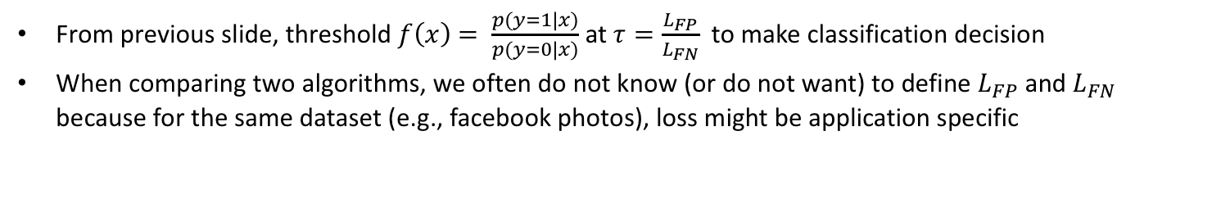
Different Metrics
From previous slide, threshold $f\left(x\right)$ $= \frac{p(y=1|x)}{p(y=0|x)}$ at $τ=\frac{L_{FP}}{L_{FN}}$ to make classification decision
When comparing two algorithms, we often do not know (or do not want) to define $L_{FP}$ and $L_{FN}$ because for the same dataset (e.g., facebook photos), loss might be application specific
Notes:
However, when comparing two algorithms, we often do not know or do not want to define the FP cost and FN cost because for the same dataset, the cost might be application specific.

Slide 77
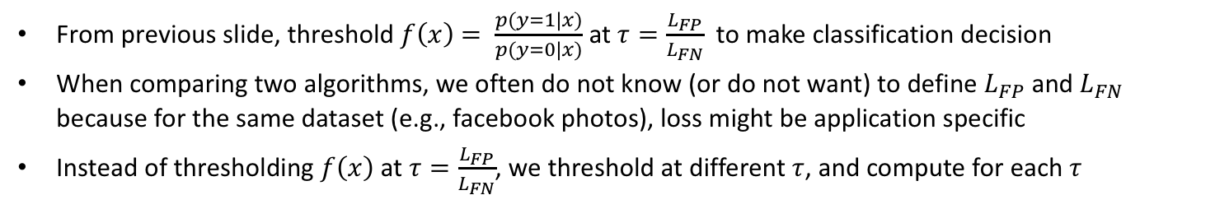
Different Metrics
From previous slide, threshold $f\left(x\right)$ $= \frac{p(y=1|x)}{p(y=0|x)}$ at $τ=\frac{L_{FP}}{L_{FN}}$ to make classification decision
When comparing two algorithms, we often do not know (or do not want) to define $L_{FP}$ and $L_{FN}$ because for the same dataset (e.g., facebook photos), loss might be application specific
Instead of thresholding $f\left(x\right)$ at $τ=\frac{L_{FP}}{L_{FN}}$, we threshold at different $τ$, and compute for each $τ$
Notes:
Therefore, instead of threshold f(x) at a particular tau, we threshold at different tau.
And for each tau, we evaluate the following:

Slide 78
Different Metrics
From previous slide, threshold $f\left(x\right)$ $= \frac{p(y=1|x)}{p(y=0|x)}$ at $τ=\frac{L_{FP}}{L_{FN}}$ to make classification decision
When comparing two algorithms, we often do not know (or do not want) to define $L_{FP}$ and $L_{FN}$ because for the same dataset (e.g., facebook photos), loss might be application specific
Instead of thresholding $f\left(x\right)$ at $τ=\frac{L_{FP}}{L_{FN}}$, we threshold at different $τ$, and compute for each $τ$
TP (true positives)
N_{TP} = # data points in test set whose true label = 1 & classified correctly as 1
N₁ = # data points in test set whose true label = 1
TPR (true positive rate or sensitivity or recall) = N_{TP} /N₁
 | ŷ = 0 | ŷ = 1
y = 0 | N_{TN} | N_{FP} | N₀ = N_{TN} + N_{FP}
y = 1 | N_{FN} | N_{TP} | N₁ = N_{FN} + N_{TP}
Notes:
NTP is the number of data points in the test set whose true label is 1 and is correctly classified as 1.
N1 is the number of data points in the test set whose true label is 1.
NTP divided by N1 is the true positive rate or sensitivity or recall.

Slide 79
Different Metrics
From previous slide, threshold $f\left(x\right)$ $= \frac{p(y=1|x)}{p(y=0|x)}$ at $τ=\frac{L_{FP}}{L_{FN}}$ to make classification decision
When comparing two algorithms, we often do not know (or do not want) to define $L_{FP}$ and $L_{FN}$ because for the same dataset (e.g., facebook photos), loss might be application specific
Instead of thresholding $f\left(x\right)$ at $τ=\frac{L_{FP}}{L_{FN}}$, we threshold at different $τ$, and compute for each $τ$
TP (true positives)
N_{TP} = # data points in test set whose true label = 1 & classified correctly as 1
N₁ = # data points in test set whose true label = 1
TPR (true positive rate or sensitivity or recall) = N_{TP} /N₁
 | ŷ = 0 | ŷ = 1
y = 0 | N_{TN} | N_{FP} | N₀ = N_{TN} + N_{FP}
y = 1 | N_{FN} | N_{TP} | N₁ = N_{FN} + N_{TP}
TN (true negatives)
N_{TN} = # data points in test set whose true label = 0 and classified correctly as 0
N₀ = # data points in test set whose true label = 0
TNR (true negative rate or specificity) = N_{TN} / N₀
Notes:
NTN is the number of data points in the test set whose true label is 0 and is correctly classified as 0.
N0 is the number of data points in the test set whose true label is 0.
NTN divided by N0 is the true negative rate or specificity

Slide 80
Different Metrics
From previous slide, threshold $f\left(x\right)$ $= \frac{p(y=1|x)}{p(y=0|x)}$ at $τ=\frac{L_{FP}}{L_{FN}}$ to make classification decision
When comparing two algorithms, we often do not know (or do not want) to define $L_{FP}$ and $L_{FN}$ because for the same dataset (e.g., facebook photos), loss might be application specific
Instead of thresholding $f\left(x\right)$ at $τ=\frac{L_{FP}}{L_{FN}}$, we threshold at different $τ$, and compute for each $τ$
TP (true positives)
N_{TP} = # data points in test set whose true label = 1 & classified correctly as 1
N₁ = # data points in test set whose true label = 1
TPR (true positive rate or sensitivity or recall) = N_{TP} /N₁
 | ŷ = 0 | ŷ = 1
y = 0 | N_{TN} | N_{FP} | N₀ = N_{TN} + N_{FP}
y = 1 | N_{FN} | N_{TP} | N₁ = N_{FN} + N_{TP}
TN (true negatives)
N_{TN} = # data points in test set whose true label = 0 and classified correctly as 0
N₀ = # data points in test set whose true label = 0
TNR (true negative rate or specificity) = N_{TN} / N₀
FP (false positives)
N_{FP} = # data points in test set whose true label = 0 and classified wrongly as 1
FPR (false positive rate or type 1 error) = N_{FP} / N₀
Notes:
NFP is the number of data points in the test set whose true label is 0 and is wrongly classified as 1.
N0 is the number of data points in the test set whose true label is 0.
NFP divided by N0 is the false positive rate or type 1 error

Slide 81
Different Metrics
From previous slide, threshold $f\left(x\right)$ $= \frac{p(y=1|x)}{p(y=0|x)}$ at $τ=\frac{L_{FP}}{L_{FN}}$ to make classification decision
When comparing two algorithms, we often do not know (or do not want) to define $L_{FP}$ and $L_{FN}$ because for the same dataset (e.g., facebook photos), loss might be application specific
Instead of thresholding $f\left(x\right)$ at $τ=\frac{L_{FP}}{L_{FN}}$, we threshold at different $τ$, and compute for each $τ$
TP (true positives)
N_{TP} = # data points in test set whose true label = 1 & classified correctly as 1
N₁ = # data points in test set whose true label = 1
TPR (true positive rate or sensitivity or recall) = N_{TP} /N₁
 | ŷ = 0 | ŷ = 1
y = 0 | N_{TN} | N_{FP} | N₀ = N_{TN} + N_{FP}
y = 1 | N_{FN} | N_{TP} | N₁ = N_{FN} + N_{TP}
TN (true negatives)
N_{TN} = # data points in test set whose true label = 0 and classified correctly as 0
N₀ = # data points in test set whose true label = 0
TNR (true negative rate or specificity) = N_{TN} / N₀
FP (false positives)
N_{FP} = # data points in test set whose true label = 0 and classified wrongly as 1
FPR (false positive rate or type 1 error) = N_{FP} / N₀
FN (false negatives)
N_{FN} = # data points in test set whose true label = 1 and classified wrongly as 0
FNR (false negative rate or type 2 error) = N_{FN} / N₁
Notes:
NFN is the number of data points in the test set whose true label is 1 and is wrongly classified as 0.
N1 is the number of data points in the test set whose true label is 1.
NFN divided by N1 is the false negative rate or type 2 error

Slide 82
Different Metrics
From previous slide, threshold $f\left(x\right)$ $= \frac{p(y=1|x)}{p(y=0|x)}$ at $τ=\frac{L_{FP}}{L_{FN}}$ to make classification decision
When comparing two algorithms, we often do not know (or do not want) to define $L_{FP}$ and $L_{FN}$ because for the same dataset (e.g., facebook photos), loss might be application specific
Instead of thresholding $f\left(x\right)$ at $τ=\frac{L_{FP}}{L_{FN}}$, we threshold at different $τ$, and compute for each $τ$
TP (true positives)
N_{TP} = # data points in test set whose true label = 1 & classified correctly as 1
N₁ = # data points in test set whose true label = 1
TPR (true positive rate or sensitivity or recall) = N_{TP} /N₁
 | ŷ = 0 | ŷ = 1
y = 0 | N_{TN} | N_{FP} | N₀ = N_{TN} + N_{FP}
y = 1 | N_{FN} | N_{TP} | N₁ = N_{FN} + N_{TP}
TN (true negatives)
N_{TN} = # data points in test set whose true label = 0 and classified correctly as 0
N₀ = # data points in test set whose true label = 0
TNR (true negative rate or specificity) = N_{TN} / N₀
FP (false positives)
N_{FP} = # data points in test set whose true label = 0 and classified wrongly as 1
FPR (false positive rate or type 1 error) = N_{FP} / N₀
FN (false negatives)
N_{FN} = # data points in test set whose true label = 1 and classified wrongly as 0
FNR (false negative rate or type 2 error) = N_{FN} / N₁
Many other possibilities: https://en.wikipedia.org/wiki/Sensitivity_and_specificity

Slide 83
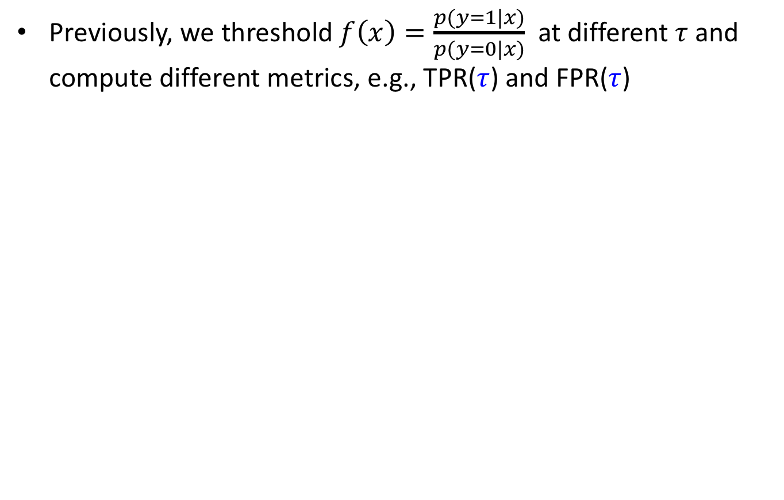
ROC (1)
Previously, we threshold $f\left(x\right)=\frac{p(y=1|x)}{p(y=0|x)}$ at different $τ$and compute different metrics, e.g., TPR($τ$) and FPR($τ$)
Notes:
In the previous slide, we threshold f(x) at different tau and compute different metrics, such as TPR and FPR.
Note that the TPR and FPR are functions of tau, so I have made this dependence explicit here.

Slide 84
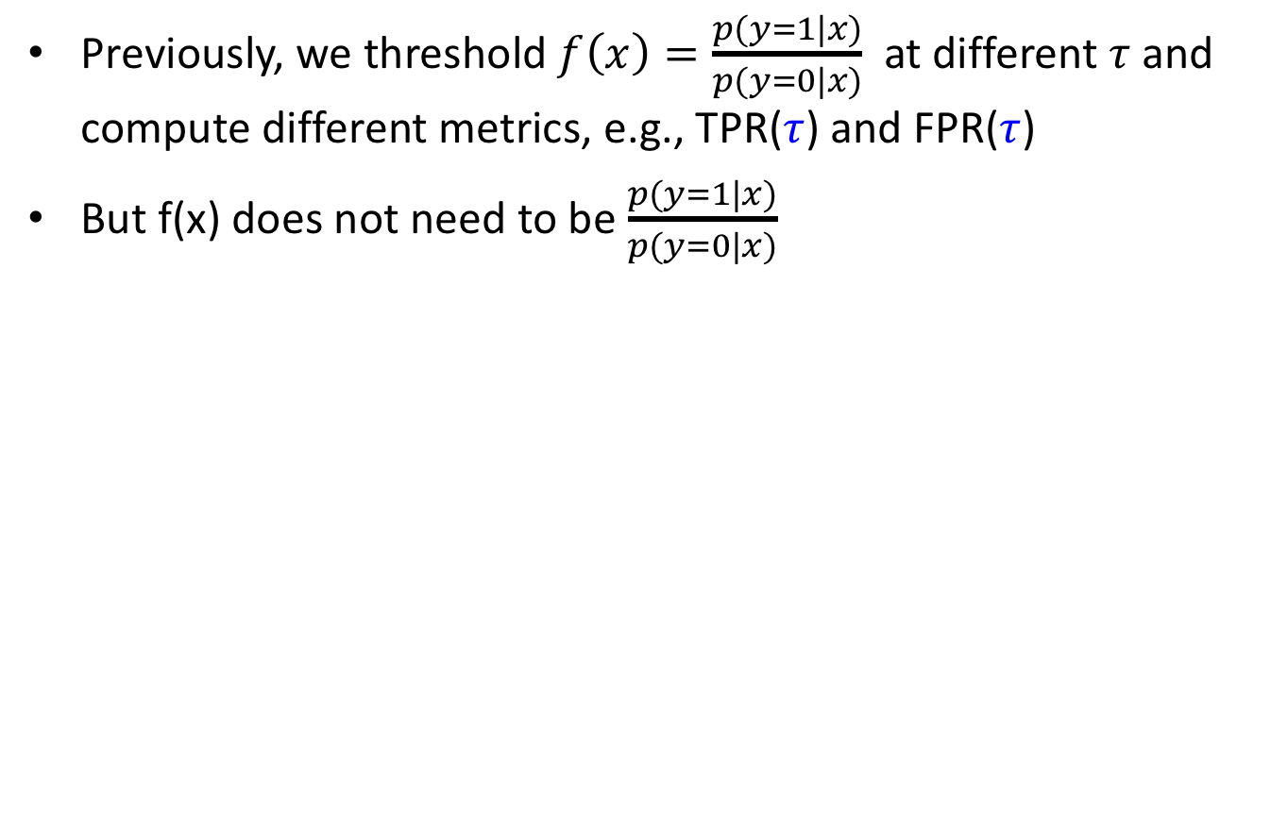
ROC (1)
Previously, we threshold $f\left(x\right)=\frac{p(y=1|x)}{p(y=0|x)}$ at different $τ$and compute different metrics, e.g., TPR($τ$) and FPR($τ$)
But f(x) does not need to be $\frac{p(y=1|x)}{p(y=0|x)}$
Notes:
But f(x) does not need to be posterior of class 1 divided by posterior of class 0.

Slide 85
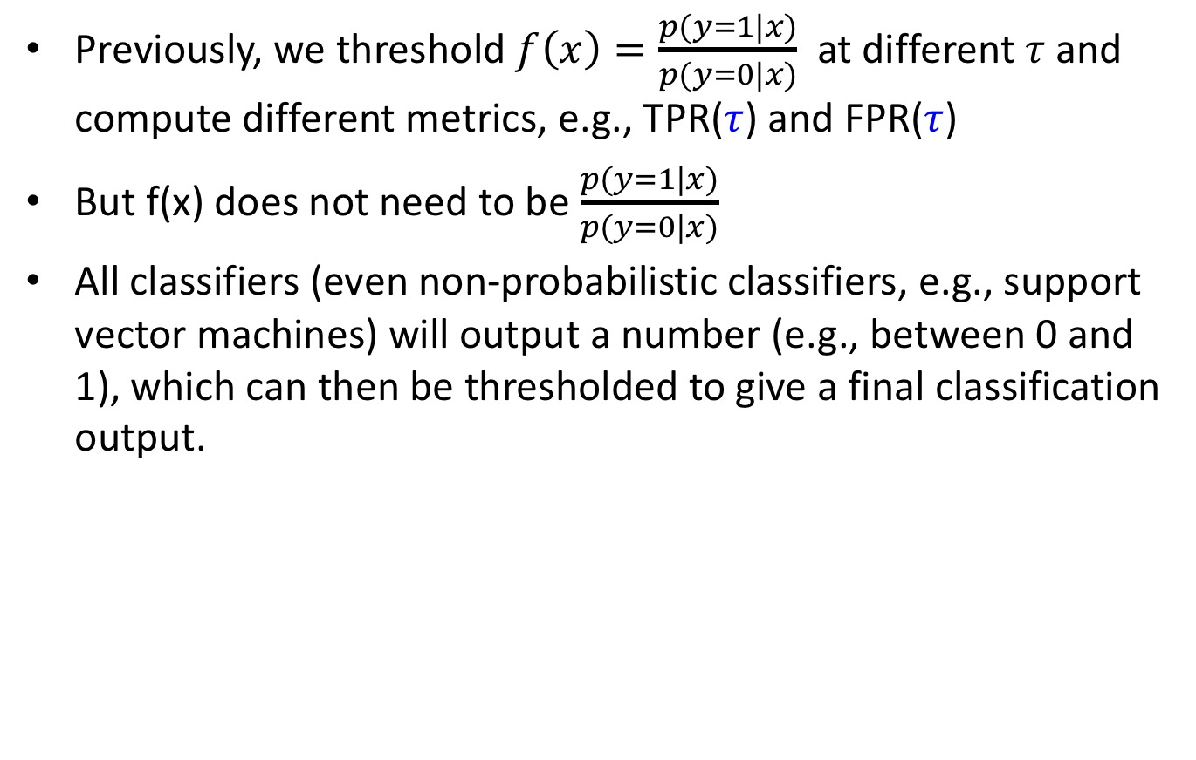
ROC (1)
Previously, we threshold $f\left(x\right)=\frac{p(y=1|x)}{p(y=0|x)}$ at different $τ$and compute different metrics, e.g., TPR($τ$) and FPR($τ$)
But f(x) does not need to be $\frac{p(y=1|x)}{p(y=0|x)}$
All classifiers (even non-probabilistic classifiers, e.g., support vector machines) will output a number (e.g., between 0 and 1), which can then be thresholded to give a final classification output.
Notes:
All classifiers, even non-probabilistic ones like support vector machines will output a number. This number might be between 0 and 1, for example.
We can then threshold the number to get a final classification decision.

Slide 86
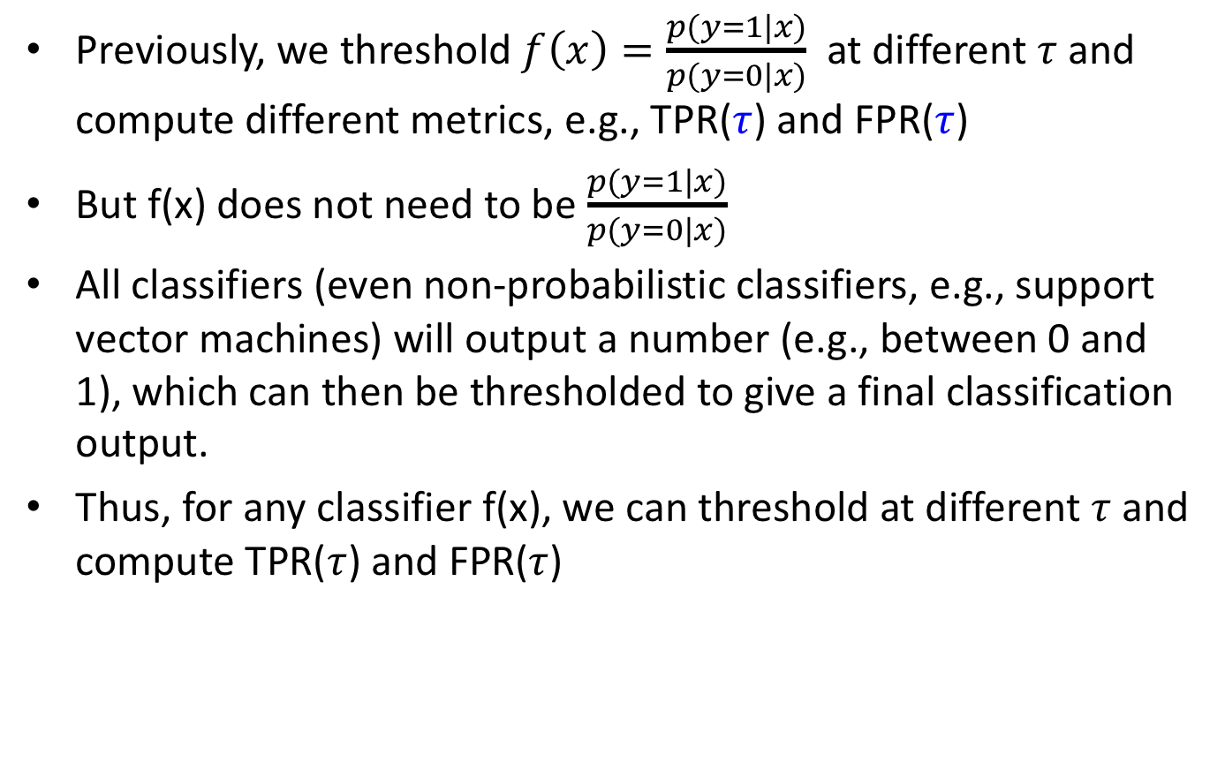
ROC (1)
Previously, we threshold $f\left(x\right)=\frac{p(y=1|x)}{p(y=0|x)}$ at different $τ$and compute different metrics, e.g., TPR($τ$) and FPR($τ$)
But f(x) does not need to be $\frac{p(y=1|x)}{p(y=0|x)}$
All classifiers (even non-probabilistic classifiers, e.g., support vector machines) will output a number (e.g., between 0 and 1), which can then be thresholded to give a final classification output.
Thus, for any classifier f(x), we can threshold at different $τ$ and compute TPR($τ$) and FPR($τ$)
Notes:
So for any classifier f(x), we can threshold at different tau and compute the TPR and FPR.

Slide 87
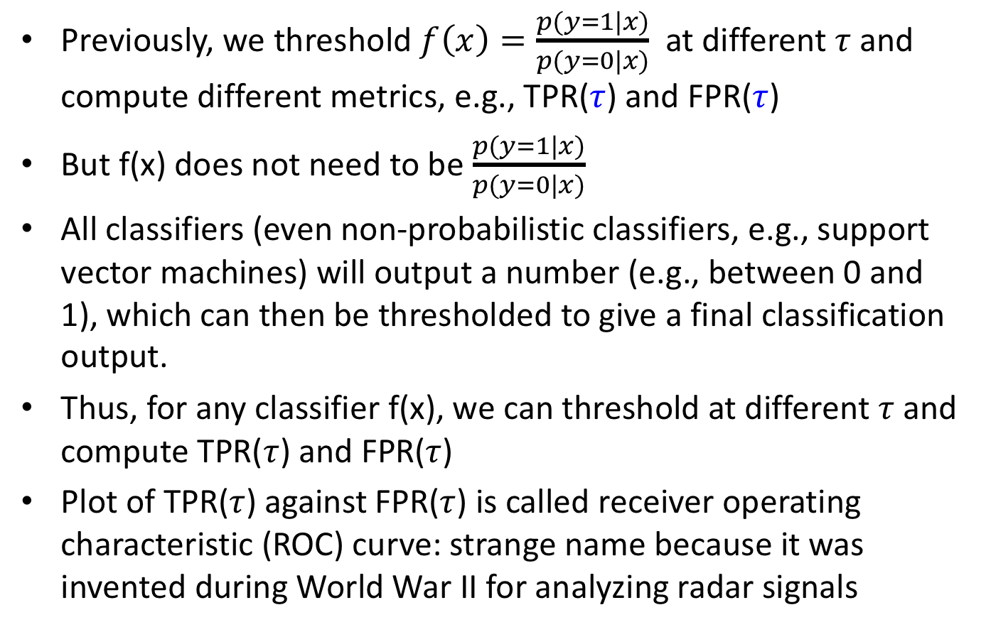
ROC (1)
Previously, we threshold $f\left(x\right)=\frac{p(y=1|x)}{p(y=0|x)}$ at different $τ$and compute different metrics, e.g., TPR($τ$) and FPR($τ$)
But f(x) does not need to be $\frac{p(y=1|x)}{p(y=0|x)}$
All classifiers (even non-probabilistic classifiers, e.g., support vector machines) will output a number (e.g., between 0 and 1), which can then be thresholded to give a final classification output.
Thus, for any classifier f(x), we can threshold at different $τ$ and compute TPR($τ$) and FPR($τ$)
Plot of TPR($τ$) against FPR($τ$) is called receiver operating characteristic (ROC) curve: strange name because it was invented during World War II for analyzing radar signals
Notes:
We can then plot the true positive rate against the false positive rate.
This is called the receiver operating characteristic or ROC curve.
The strange name comes from the fact that it was invented during World War II for analyzing radar signals.

Slide 88
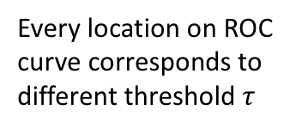
ROC Curve (2)
Red and blue curves are ROC curves for classifiers A and B
1
Every location on ROC curve corresponds to different threshold $τ$
TPR
0
0
FPR
1
Notes:
So the red and blue curves are the ROC curves of two classifiers A and B.
X-axis is the FPR, y-axis is the TPR
Every point on the two curves correspond to a different threshold tau.

Slide 89
ROC Curve (2)
Red and blue curves are ROC curves for classifiers A and B
1
Every location on ROC curve corresponds to different threshold $τ$
TPR
0
Every data point classified as 0, so TPR = 0 & FPR = 0
0
FPR
1
Notes:
The two curves meet at the bottom left corner, corresponding to a true positive rate of 0 and a false negative rate of 0. We can achieve this by classifying everything to be class 0.

Slide 90
ROC Curve (2)
Red and blue curves are ROC curves for classifiers A and B
Every data point classified as 1, so TPR = 1 & FPR = 1
1
Every location on ROC curve corresponds to different threshold $τ$
TPR
0
Every data point classified as 0, so TPR = 0 & FPR = 0
0
FPR
1
Notes:
The two curves also meet at the top right, corresponding to a true positive rate of 1 and a false negative rate of 1. We can achieve this by classifying everything to be class 1.

Slide 91
ROC Curve (2)
Red and blue curves are ROC curves for classifiers A and B
100% accuracy (TPR = 1, FPR = 0)
Every data point classified as 1, so TPR = 1 & FPR = 1
1
Every location on ROC curve corresponds to different threshold $τ$
TPR
0
Every data point classified as 0, so TPR = 0 & FPR = 0
0
FPR
1
Notes:
The top left hand corner corresponds to 100% true positive and 0% false negative.
This is the best corner. The closer a ROC curve is to this corner, the better.

Slide 92
ROC Curve (2)
Red and blue curves are ROC curves for classifiers A and B
100% accuracy (TPR = 1, FPR = 0)
Every data point classified as 1, so TPR = 1 & FPR = 1
Every data point classified as 1, so TPR = 1 & FPR = 1
1
Every location on ROC curve corresponds to different threshold $τ$
TPR
0
Every data point classified as 0, so TPR = 0 & FPR = 0
0
FPR
1
“A” better than “B” because for any FPR, “A” achieves higher TPR than B
Notes:
Therefore A is a better classifier than B because it is closer to the top left hand corner.
More specifically, notice that for any FPR, “A” can achieve a better TPR than ”B”.

Slide 93
ROC Curve (2)
Red and blue curves are ROC curves for classifiers A and B
100% accuracy (TPR = 1, FPR = 0)
Every data point classified as 1, so TPR = 1 & FPR = 1
Every data point classified as 1, so TPR = 1 & FPR = 1
1
Every location on ROC curve corresponds to different threshold $τ$
“A” better than “B” because for any TPR, “A” achieves lower FPR than B
TPR
0
Every data point classified as 0, so TPR = 0 & FPR = 0
0
FPR
1
“A” better than “B” because for any FPR, “A” achieves higher TPR than B
Notes:
In addition, for any TPR, “A” achieves a lower false positive rate than B.

Slide 94
ROC Curve (2)
Red and blue curves are ROC curves for classifiers A and B
Sometimes two curves intersect, so useful to summarize ROC curve with one number
100% accuracy (TPR = 1, FPR = 0)
Every data point classified as 1, so TPR = 1 & FPR = 1
1
TPR
0
Every data point classified as 0, so TPR = 0 & FPR = 0
0
FPR
1
Notes:
Sometimes, two ROC curves might intersect, in which case it’s hard to say which classifier is better because it depends on which operating regime we are interested in.
So one may compute a statistic to summarize the entire ROC curve.

Slide 95
ROC Curve (2)
Red and blue curves are ROC curves for classifiers A and B
Sometimes two curves intersect, so useful to summarize ROC curve with one number
Blue area = area under the curve (AUC) for classifier B
100% accuracy (TPR = 1, FPR = 0)
Every data point classified as 1, so TPR = 1 & FPR = 1
1
TPR
0
Every data point classified as 0, so TPR = 0 & FPR = 0
0
FPR
1
Notes:
One common measure is the area under the ROC curve. So the blue area shown here is the area under the ROC curve for classifier B.
Classifier B has a larger AUC than classifier A, so under this criterion, classifier B is better than classifier A.

Slide 96
ROC Curve (2)
Red and blue curves are ROC curves for classifiers A and B
Sometimes two curves intersect, so useful to summarize ROC curve with one number
Blue area = area under the curve (AUC) for classifier B
Intersection between black diagonal line and ROC: equal error rate (EER)
100% accuracy (TPR = 1, FPR = 0)
Every data point classified as 1, so TPR = 1 & FPR = 1
1
TPR
0
Every data point classified as 0, so TPR = 0 & FPR = 0
0
FPR
1
Notes:
The intersection between the black line and the ROC curve is called the equal error rate.
Because at the intersections, the false positive rate is equal to the false negative rate.
And again, we see that classifier A has a lower equal error rate than classifier B.

Slide 97
ROC Curve (2)
Red and blue curves are ROC curves for classifiers A and B
Sometimes two curves intersect, so useful to summarize ROC curve with one number
Blue area = area under the curve (AUC) for classifier B
Intersection between black diagonal line and ROC: equal error rate (ERR)
100% accuracy (TPR = 1, FPR = 0)
Every data point classified as 1, so TPR = 1 & FPR = 1
1
Below this black line, TPR < FPR
ROC curve should not be below the black diagonal.
If you have classifier like this, just predict the opposite of what the classifier says
TPR
0
Every data point classified as 0, so TPR = 0 & FPR = 0
0
FPR
1
Notes:
Finally, consider this black line that goes from bottom left to top right.
Anything below the black line is bad, because the true positive rate is actually worse than the false positive rate.
So for example, this ROC curve is very bad. And in fact, if you have a classifier like this, then you should predict the opposite of what the classifier says, and this red ROC curve will flip over to the other side of the black diagonal.

Slide 98
Summary
Problems With MAP estimation
Mode (MAP) of a distribution might be atypical
MAP sensitive to parameterization
Notes:
To summarize, today, we first discuss about the problem with MAP estimation.
MAP is the mode of the posterior distribution. But the mode of a distribution has zero probability mass, so it can be “atypical”. In other words, there might be no chance of the true value being anywhere close to the mode.

Slide 99
Summary
Problems With MAP estimation
Mode (MAP) of a distribution might be atypical
MAP sensitive to parameterization
Bayesian model selection
Automatically select for sufficiently complex (but not too complex) model that can explain data well
Approximations often needed, e.g., BIC
Notes:
I also show you that Bayesian model selection automatically select for sufficiently complex model that can explain data well. But not so complex that it might overfit.
However, Bayesian model selection is usually difficult to compute unless we deal with nice conjugate priors. If not we need approximations like Bayesian information criterion.

Slide 100
Summary
Problems With MAP estimation
Mode (MAP) of a distribution might be atypical
MAP sensitive to parameterization
Bayesian model selection
Automatically select for sufficiently complex (but not too complex) model that can explain data well
Approximations often needed, e.g., BIC
Bayesian decision theory
Minimize posterior expected loss when making decisions
Notes:
Once we have the posterior distribution, we can make our decision by minimizing the posterior expected loss

Slide 101
Summary
Problems With MAP estimation
Mode (MAP) of a distribution might be atypical
MAP sensitive to parameterization
Bayesian model selection
Automatically select for sufficiently complex (but not too complex) model that can explain data well
Approximations often needed, e.g., BIC
Bayesian decision theory
Minimize posterior expected loss when making decisions
ROC curves
Notes:
I also show you the concept of ROC curves.

Slide 102
Optional Reading
Notes based on
KM Chapter 5 (beware of typos)

Slide 103
Additional Material
Notes:
So far so good? Let’s go on to multivariate gaussian or normal distributions. We will be discussing some of their important properties.

Slide 104
Laplace Approximation

Slide 105
Proof of BIC

